Slide 1
Word Embeddings for Text
Diplomado de especialización de
desarrollo de aplicaciones con Inteligencia Artificial

Slide 2
Colaboradores:
Erasmo Gomez
Gina Bustamante

Slide 3
What Are Word Embeddings for Text?
One of the key breakthroughs in deep learning for NLP
Key to the approach is the idea of using a dense distributed representation for each word.
The distributed representation is learned based on the usage of words.
Words that have similar context will have similar meanings. “distributional hypothesis”.
“A word is characterized by the company it keeps” - Firth 1957

Slide 4
Word Embedding Algorithms
Word embedding methods learn a real-valued vector representation for a predefined fixed sized vocabulary from a corpus of text.
The learning process is either joint with the neural network model on some task, such as document classification, or is an unsupervised process, using document statistics.

Slide 5
Algorithms - Embedding Layer (1)
Learned jointly with a neural network for an specific nlp task such as: Language Modeling or Document Classification.
It requires that document text be cleaned and prepared such that each word is one-hot encoded.
The embedding layer is used on the front end of a neural network and is fit in a supervised way using the Backpropagation algorithm.

Slide 6
Algorithms - Embedding Layer (2)
If a multilayer Perceptron model is used, then the word vectors are concatenated before being fed as input to the model. If a recurrent neural network is used, then each word may be taken as one input in a sequence.
This approach of learning an embedding layer requires a lot of training data and can be slow.
Learn embeddings targeted to the specific text data could be good.

Slide 7
Algorithms - Word2Vec (1)
Word2Vec is a statistical method for efficiently learning a standalone word embedding from a text corpus.
It was developed by Tomas Mikolov, et al. at Google in 2013 as a response to make the neural-network-based training of the embedding more efficient and since then has become the de facto standard for developing pre-trained word embedding.

Slide 8
Algorithms - Word2Vec (2)
Additionally, the work involved analysis of the learned vectors and the exploration of vector math on the representations of words.
For example, that subtracting the “man-ness” from “King” and adding “women-ness” results in the word “Queen“, capturing the analogy “king is to queen as man is to woman“.

Slide 9
Algorithms - Word2Vec (3)
Two different learning models were introduced that can be used as part of the word2vec approach to learn the word embedding; they are:
Continuous Bag-of-Words, or CBOW model.
Continuous Skip-Gram Model.

Slide 10
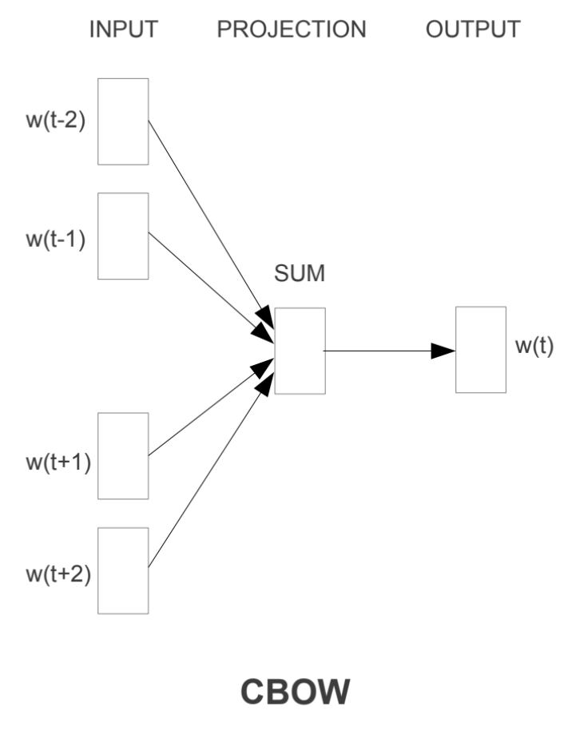
Algorithms - CBOW Model (3.1)
The CBOW model learns the embedding by predicting the current word based on its context.

Slide 11
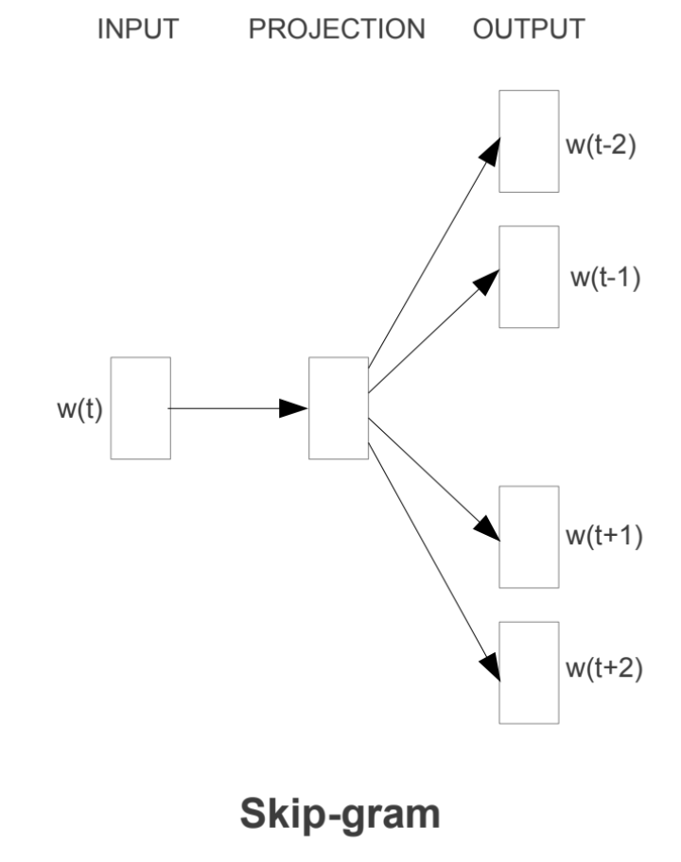
Algorithms - Skip-Gram Model (3.2)
The continuous skip-gram model learns by predicting the surrounding words given a current word.

Slide 12
Algorithms - Word2Vec (4)
Both models are focused on learning about words given their local usage context, where the context is defined by a window of neighboring words. This window is a configurable parameter of the model.
The key benefit of the approach is that high-quality word embeddings can be learned efficiently (low space and time complexity), allowing larger embeddings to be learned (more dimensions) from much larger corpora of text (billions of words).

Slide 13
Algorithms - GloVe
Global Vectors for word representation is an extension of Word2Vec for efficiently learning word vectors.
Using Latent Semantic Analysis (LSA) as a matrix factorization technique. Good for global text statistics.
GloVe is an approach to marry both the global statistics of matrix factorization techniques like LSA with the local context-based learning in word2vec.

Slide 14
Using Word Embeddings - Learn an Embedding
Learn Jointly, where the embedding is learned as part of a large task-specific model. This is a good approach if you only intend to use the embedding on one task.
Learn it Standalone, where a model is trained to learn the embedding, which is saved and used as a part of another model for your task later. This is a good approach if you would like to use the same embedding in multiple models.

Slide 15
Using Word Embeddings - Reuse an Embedding
Pre-trained word embeddings available for free.
For example, both word2vec and GloVe word embeddings are available for free download 😄.

Slide 16
Using Word Embeddings - Reuse an Embedding
Static, where the embedding is kept static and is used as a component of your model. This is a suitable approach if the embedding is a good fit for your problem and gives good results.
Updated, where the pre-trained embedding is used to seed the model, but the embedding is updated jointly during the training of the model. This may be a good option if you are looking to get the most out of the model and embedding on your task.

Slide 17
Which Option Should You Use?
Explore the different options, and if possible, test to see which gives the best results on your problem.
Perhaps start with fast methods, like using a pre-trained embedding, and only use a new embedding if it results in better performance on your problem.

Slide 18
Pasemos a la parte práctica ...

